Slide 1

Haptic Interface in a networked virtual environment
Pirmin, Pepijn, Derk & Chevan

Slide 2
Inleiding
Project flowchart
Haptic device in Unity
Network Architecture Simulation
ALVR
Vorige sprint (retrospective)
Volgende sprint (sprint backlog)

Slide 3
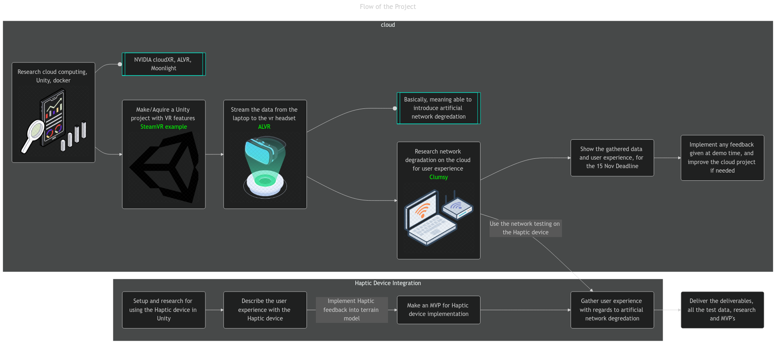
Project flowchart

Slide 4
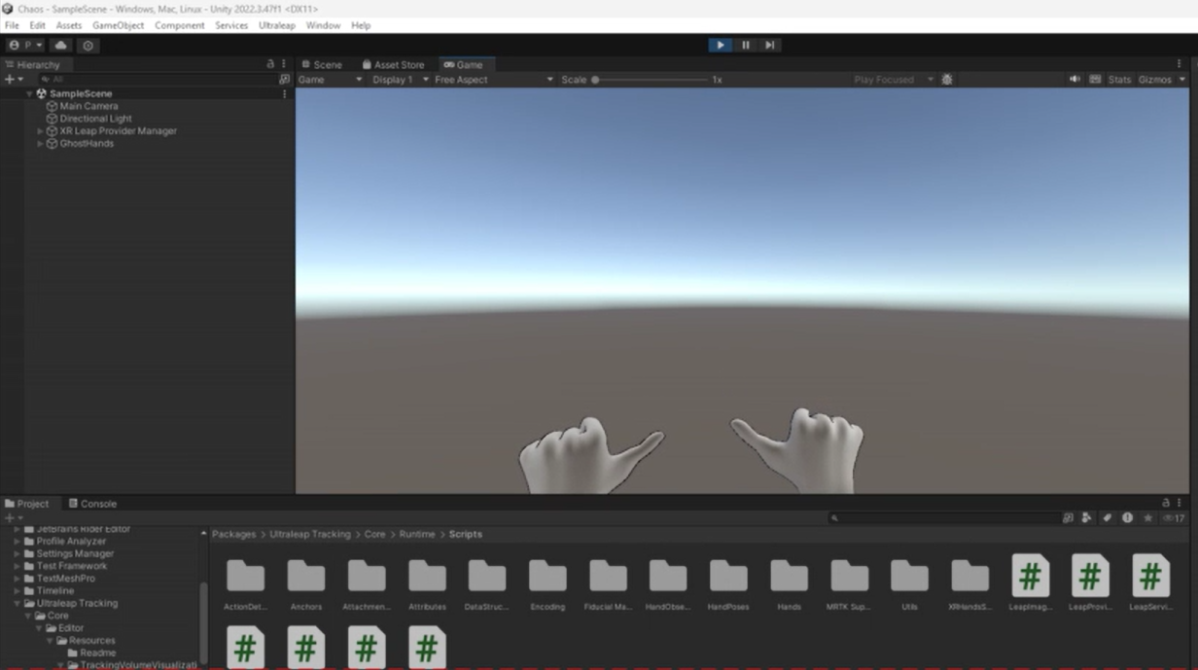
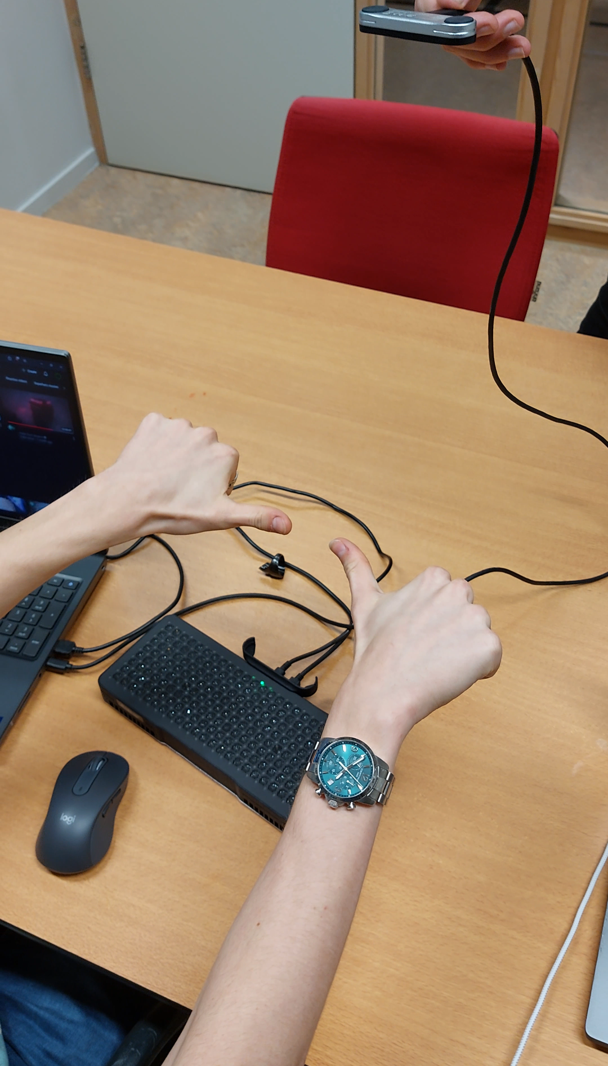
Haptic device in Unity 5. Haptic feedback needs to allow clients to control movement

Slide 5
Network architecture simulation
 | NVIDIA CloudXR | ALVR | Moonlight
Cost | Paid* | Free & Open-source | Free
Purpose | Professional VR/AR cloud streaming | PC VR wireless streaming to headsets | General game streaming (non-VR focus)
Supported Platforms | Cloud & PC | PC (windows, Linux) | PC (Windows, Linux, macOS)
Wireless Streaming | Yes (optimized for cloud-based VR) | Yes | Yes (but focused on general gaming)
VR Support | Fully optimized for VR & AR | Designed specifically for VR streaming | Not designed for VR
Additional advantage | Clearly supports for cloud | Supports PhoneVR, which can be great for testing. | Ease of setup, with regards to streaming, unsure about the controls (VR), or a second client. Extra laptops needed. Not wireless.

Slide 6
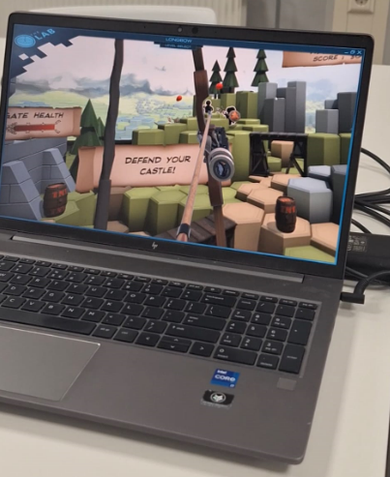
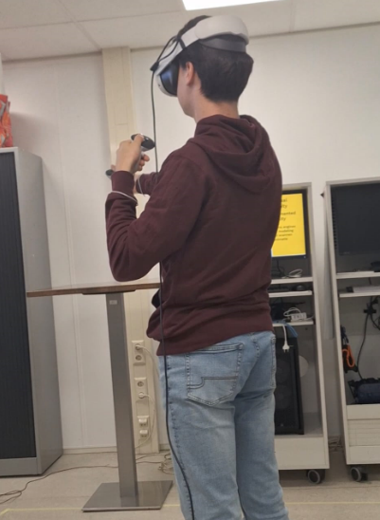
ALVR
Onmerkbare input delay
Soms stutters, door wifi/laptop
Quality vs framerate en latency
Unity->SteamVR->ALVR->Headset
Voorkeur opdrachtgever is quest
1. Connect the VR via Internet to the 'remote' server (laptop)
0. The XR needs to be simulated on a 'remote' server
4. Rendering needs to happen on the 'remote' server only

Slide 7
Vorige sprint (Retrospective)
Basisonderdelen verwerken (Risk, Planning, Backlogs)
VR headset bij VR Lab
Haptic Gloves?
Onderzoek Latency Generation
Gesprek met stakeholder TNO (Nico)

Slide 8
Volgende Sprint
Network statistics tool (must, 7. User experience must be gathered, with network degradation ) Pe, De
Multiplayer, twee VR headsets (should, 12. Multiplayer Feature Implementation) Pe, De
Dockerize, ALVR, SteamVR? Unity? (should, 0. The XR needs to be simulated on a 'remote' server) Pe, De
Ultrasonic array in Unity/Andere device (must, 5. Haptic feedback needs to allow clients to control movement) Pi, Ch
Verbetering product backlog (iedereen)
Gesprek stakeholder RDM R&D (Verduidelijking Haptic Interface) (iedereen)

